Slide 1
In-depth Product Reviews
BY:
Parul Bhutani Wadhwa
Snehal kathiriya

Slide 2
NLP and Sentimental Analysis
NLP is an area of artificial intelligence that deals with how computers and humans interact with each other through natural language. NLP uses a variety of techniques and algorithms to understand, comprehend, and create human language in a useful way.
Sentiment analysis is one of the most important applications of NLP. It uses algorithms to extract, measure, and analyze subjective information from text. It analyzes the sentiment expressed by a piece of text and classifies it as good, bad, or neutral.

Slide 3
How It Works
Text Preprocessing
TextBlob for Sentiment Analysis
Topic Modelling
Machine learning
Interpreting Mobile Reviews

Slide 4

1) Text-Preprocessing
Cleaning and preparing text data.
Tokenization, stopword removal, and stemming.

Slide 5
2) TextBlob for Sentiment Analysis
The processed text is fed into TextBlob's sentiment analysis model, where each word is assigned a sentiment score known as 'polarity.' The overall sentiment score is then determined based on the lexicon of the text. The word polarity is a numerical value that signifies the sentiment of the text, ranging from -1 (indicating the most negative sentiment) to 1 (indicating the most positive sentiment).

Slide 6
3) Topic Modelling
Using LDA (Latent Dirichlet Allocation) for topic modeling.
Negative Review Analysis:
Identifying common themes or issues in negative reviews.
Positive Review Analysis:
Gaining insights into positive aspects.

Slide 7
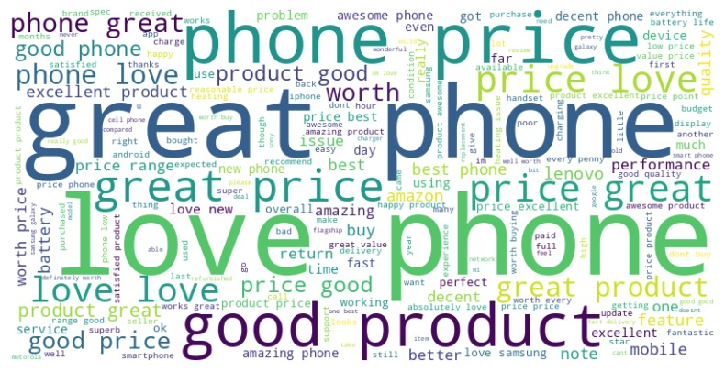
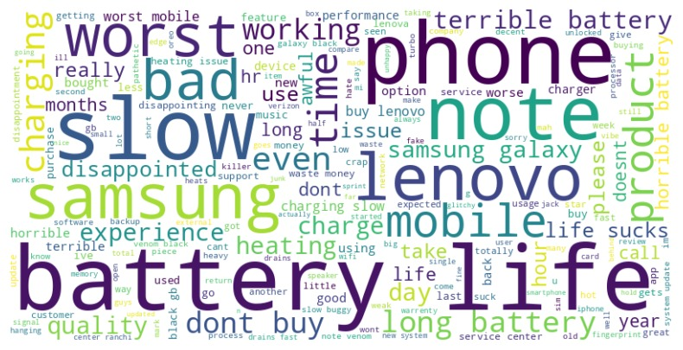
5) Interpreting Mobile Reviews

Slide 8
5) Interpreting Mobile Reviews

Slide 9
5) Interpreting Mobile Reviews

Slide 10
5) Machine learning:
Using the output from topic modeling to create a machine learning model.
Model Accuracy Scores:
Naive Bayes: 82%
Gradient Boosting Classifier: 92%
Random Forest Classifier: 93.7%
Logistic Regression: 93.1%
SVM: 93.6%
Final Model Selection: Random Forest Classifier (93.7% accuracy).

